Slide 1
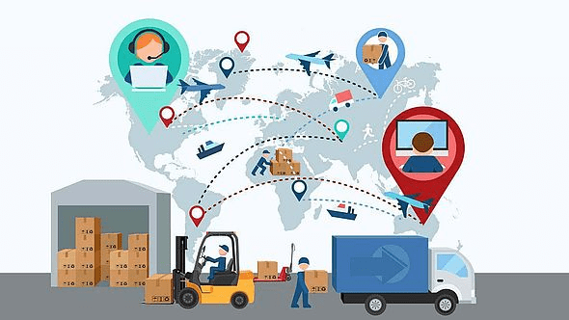
Logistic management system

Slide 2
A Logistic Management System (LMS) is a digital solution designed to streamline, automate, and optimize the flow of goods, services, and information across the supply chain.
Inventory Management – Real-time tracking of stock levels and locations
Order Processing – Automated handling from order placement to delivery
Fleet Management – Monitoring and scheduling of transportation vehicles
Warehouse Management – Efficient storage, picking, and packing processes
Data Analytics – Insights for better decision-making and forecasting

Slide 3
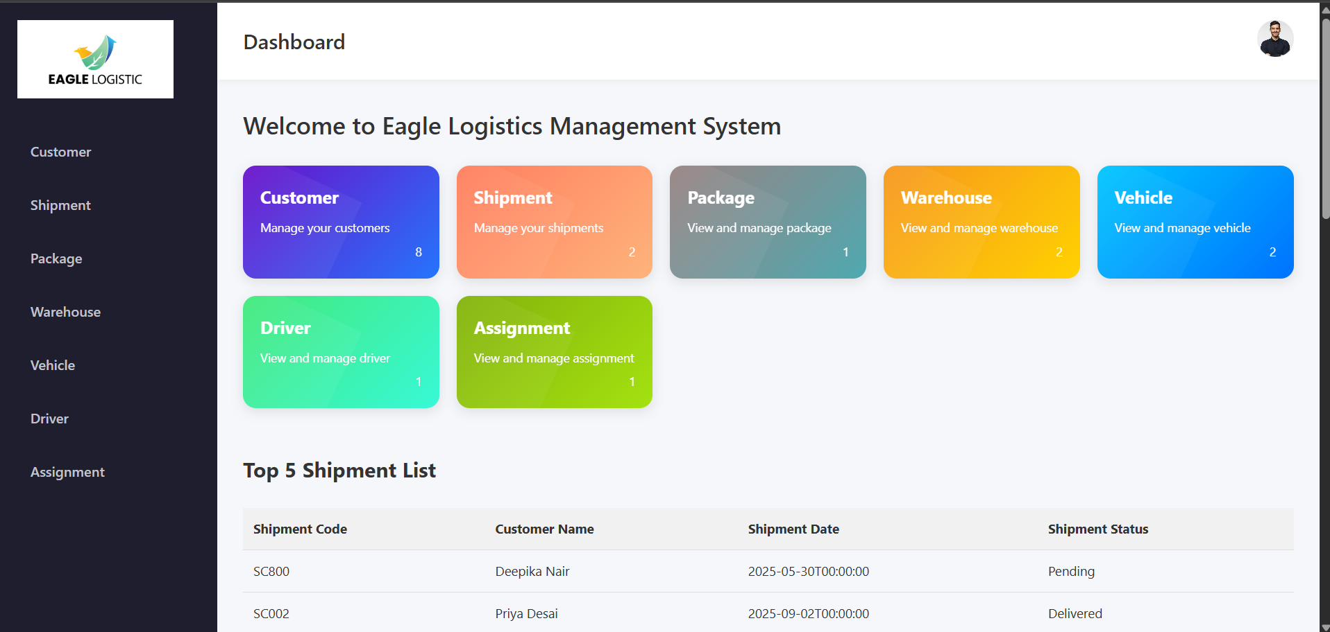
Eagle Logistic Dashboard

Slide 4
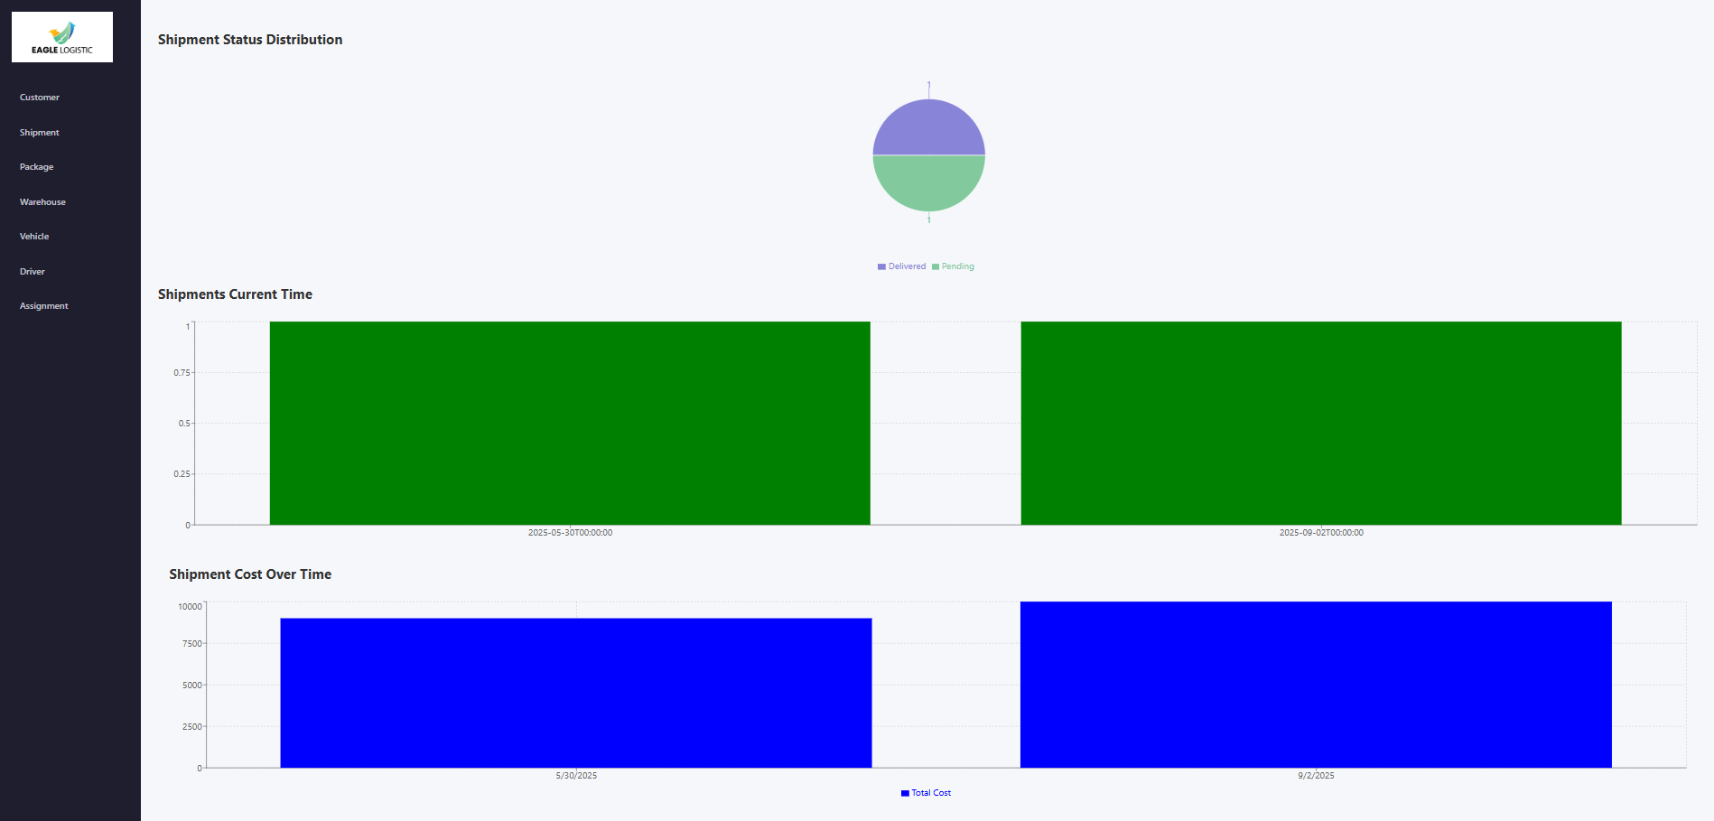
Shipment data visualization

Slide 5
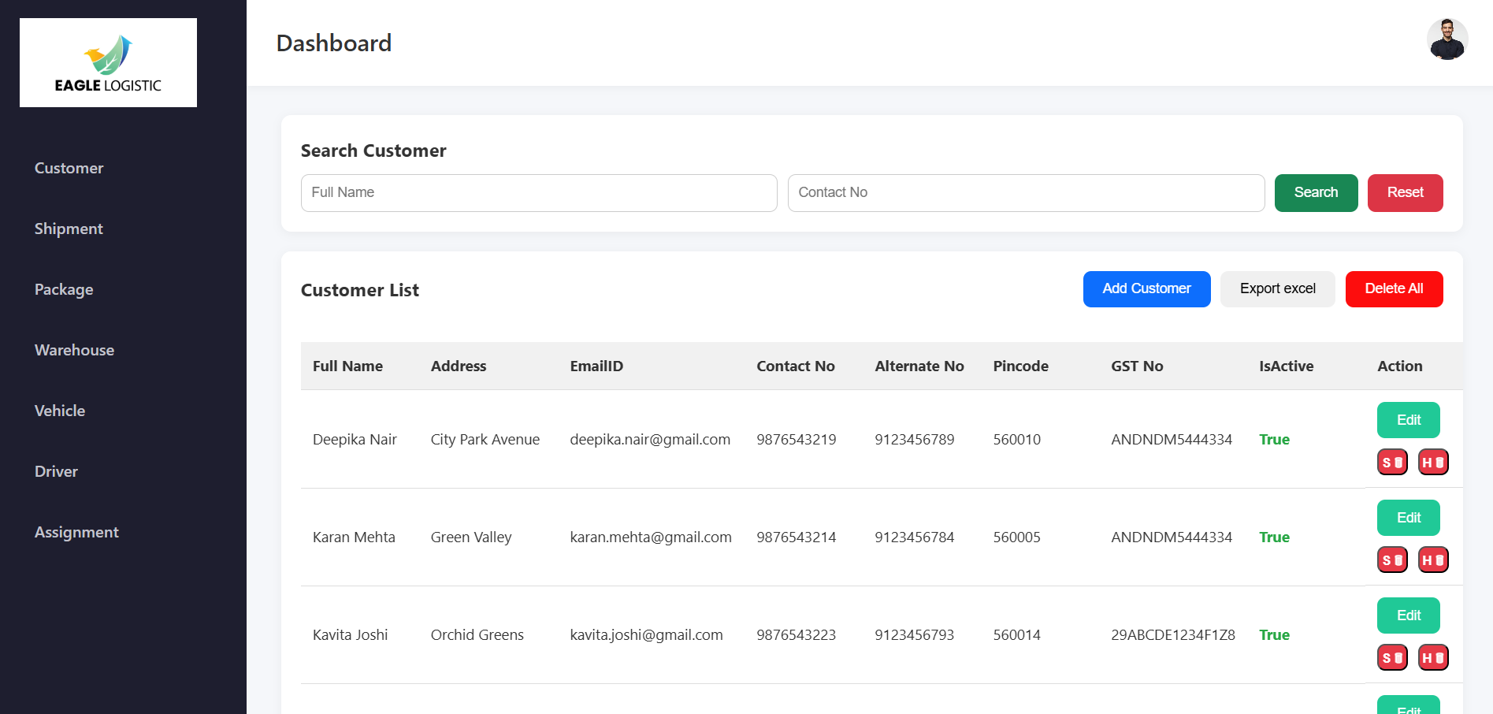
Customer data

Slide 6
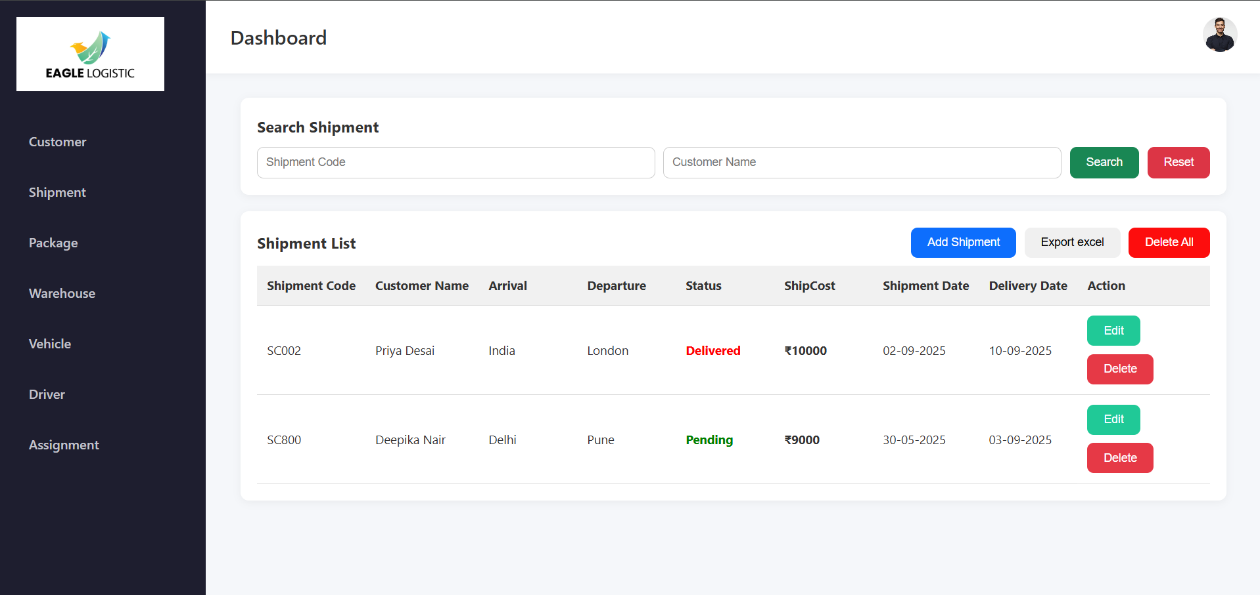
Shipment data (order)

Slide 7
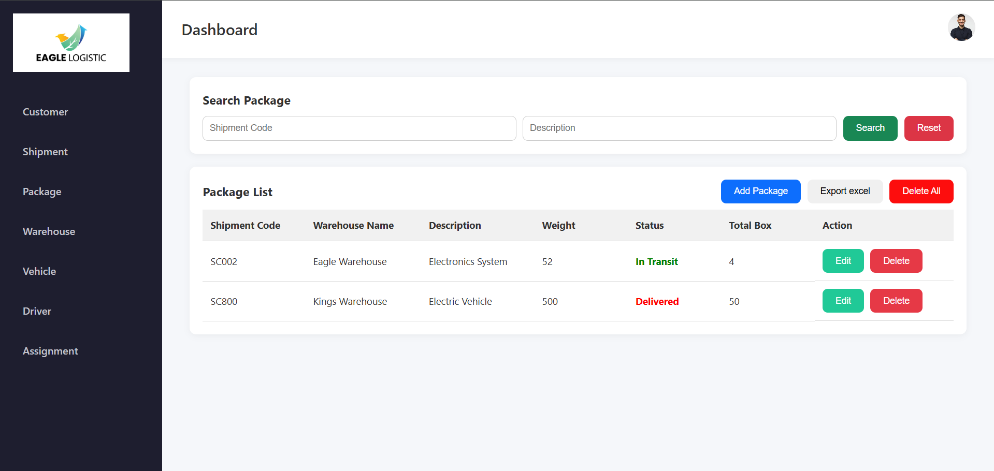
Package data (product)

Slide 8
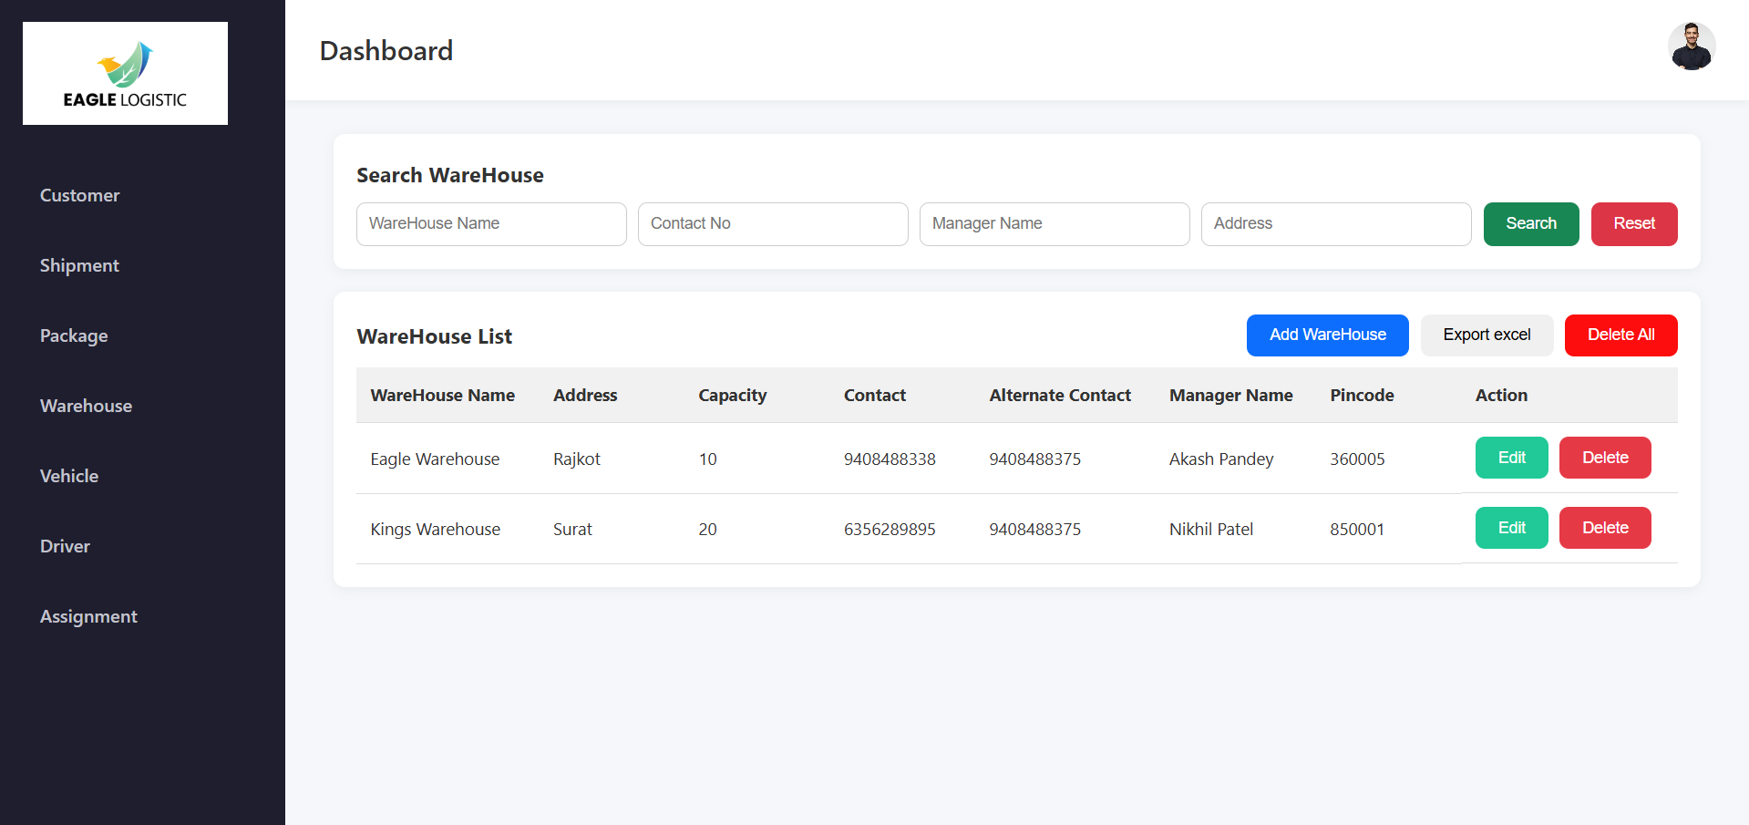
Warehouse data

Slide 9
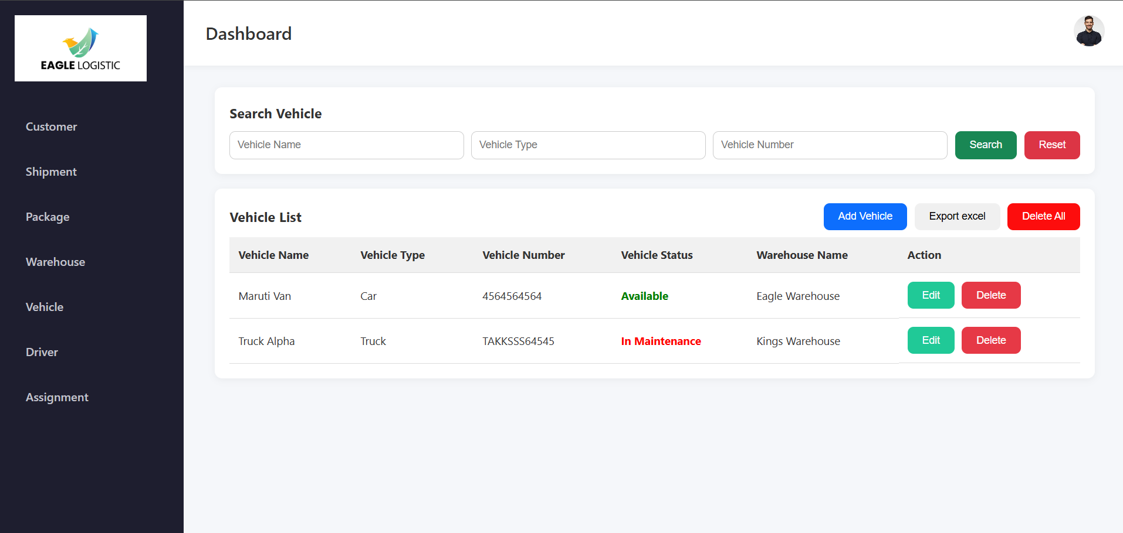
Vehicle data

Slide 10
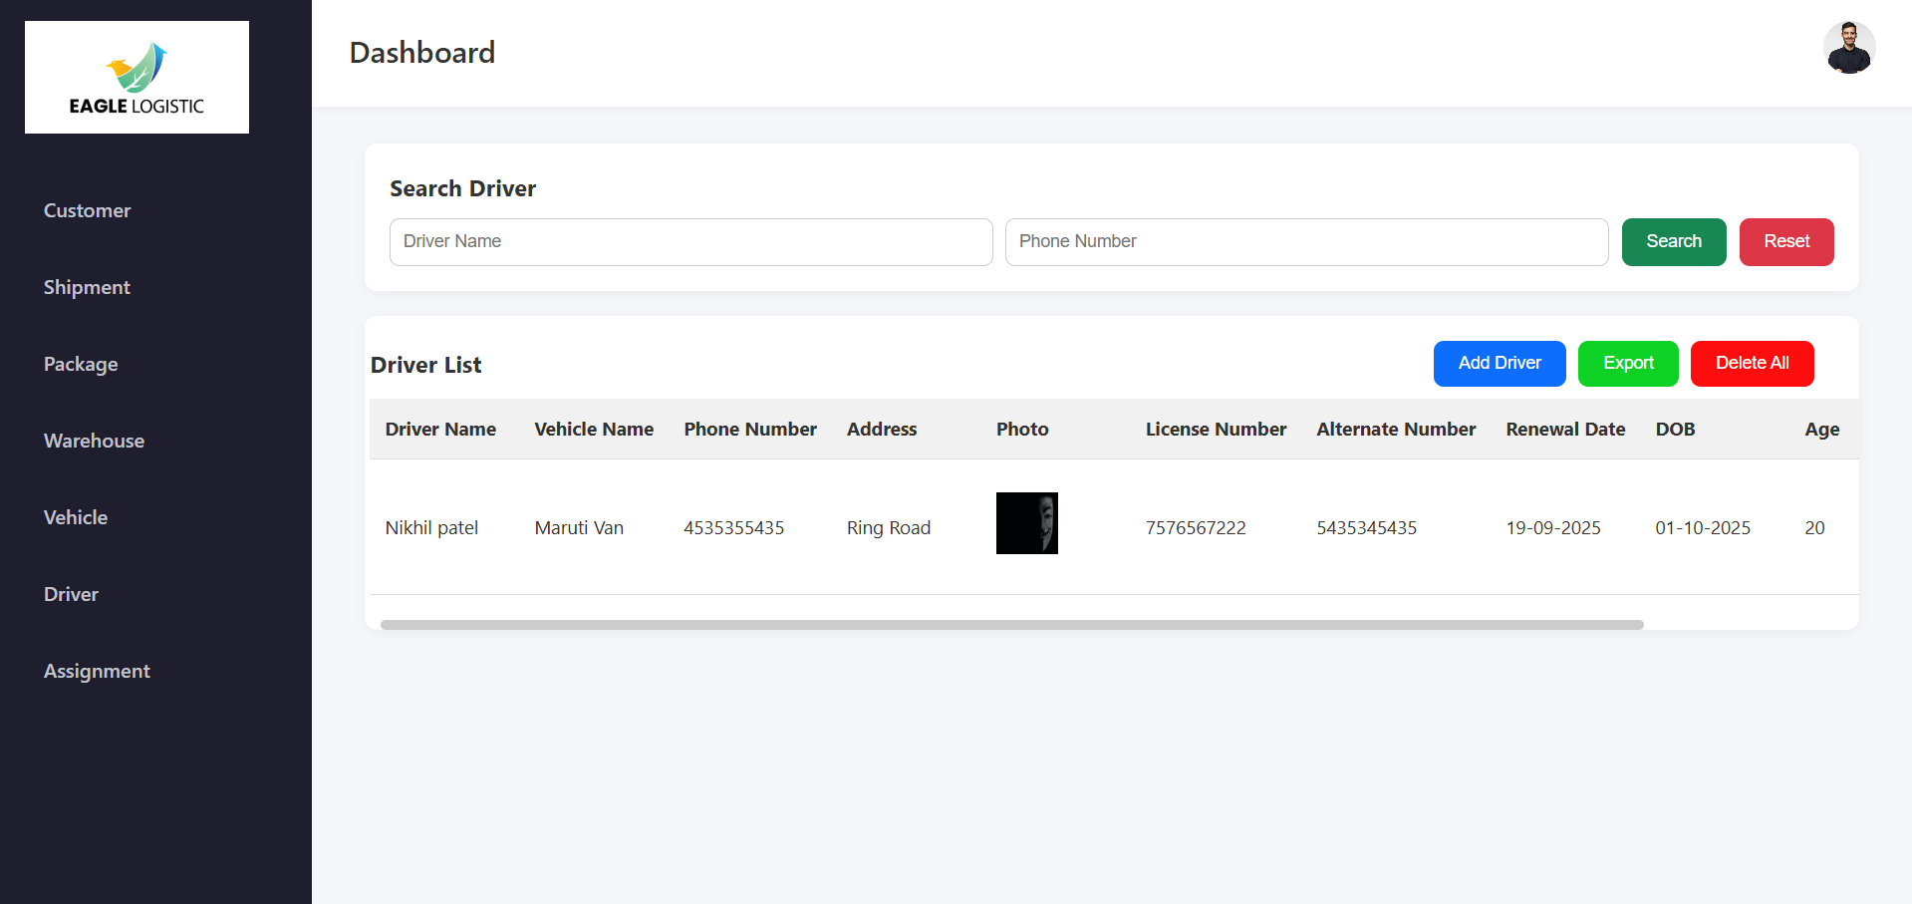
Driver data

Slide 11
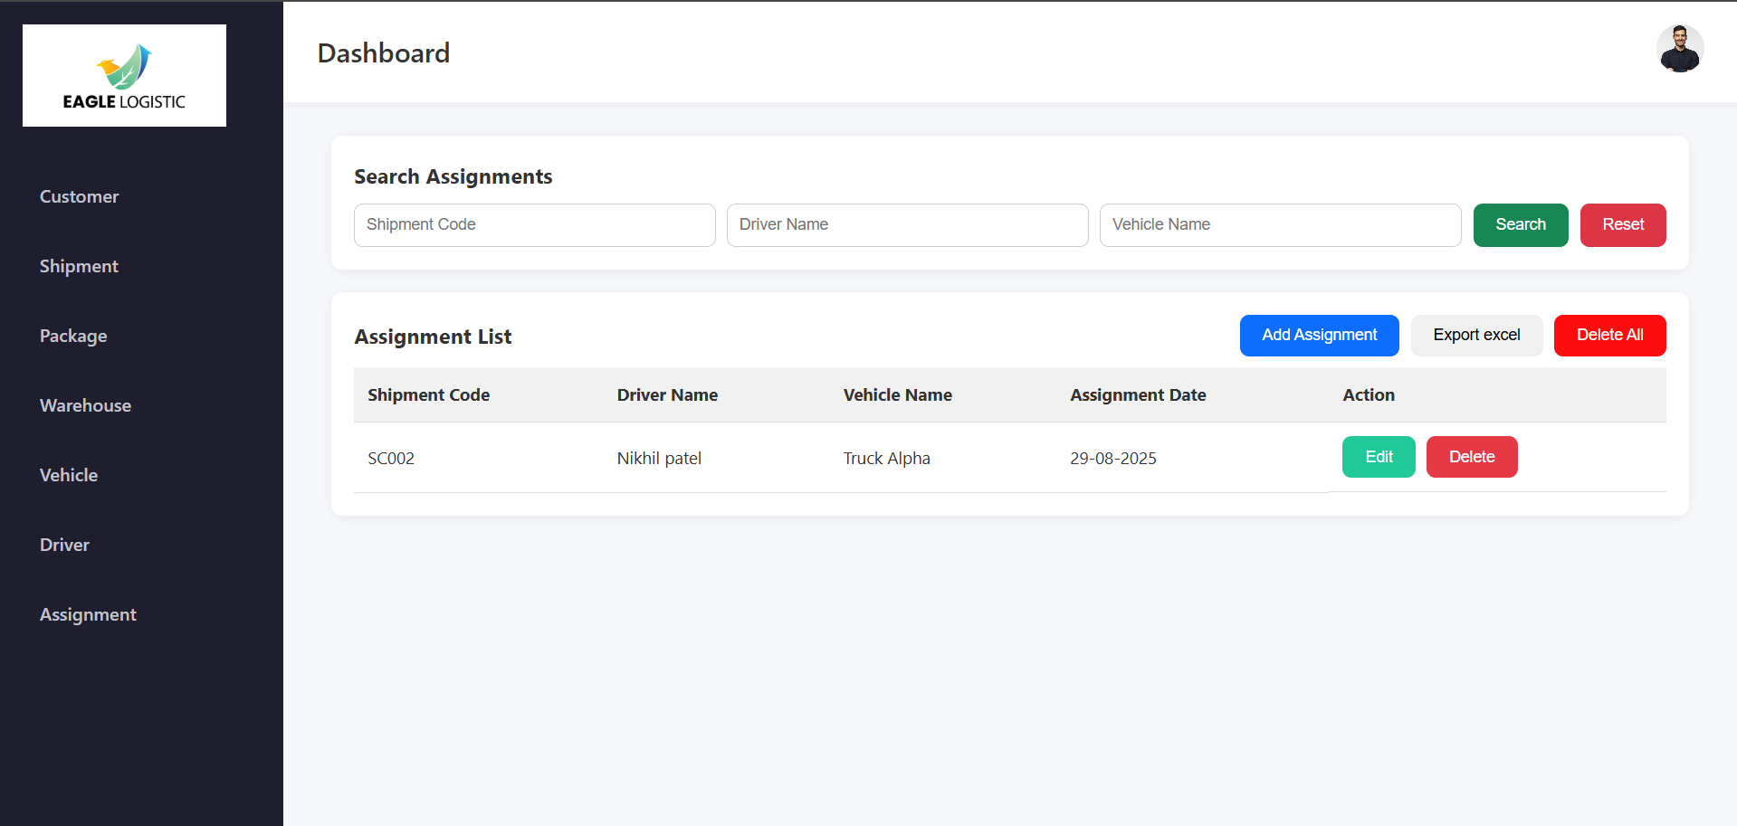
Assignment data

Slide 12
Thank you

